Slide 1
ADVANCES IN DATA SCIENCE AND ARCHITECTURE
GROUP 10
STROKE PREDICTION USING DATA SCIENCE
PROJECT BY-
MANSI ZOPE (001581273)
NEERAJA DIXIT (001584742)
VRAJ MASHRUWALA (001004658)

Slide 2
PROBLEM STATEMENT & IMPORTANCE
Worldwide, stroke is 2nd major reason of death with an annual mortality rate of 5.5 million (11% of total deaths)
A stroke is generally result of disregarding the healthy lifestyle and good eating habits
However, heart strokes are preventable in up to 80% of the cases
Stroke prediction in such cases becomes important to prevent any permanent damage it will cause
The dataset being used contains factors that highlight the lifestyle of the patient which can be indicative of probability of a stroke
Stroke prediction is done by building AI based machine learning models on this dataset

Slide 3
SOLUTION
In order to build a stroke prediction model, we have tried 3 different algorithms and did hyperparameter tuning to get the best possible model.
The steps we followed for model training are-
1. Imported libraries & dataset
2. Data Exploration to find out insights on the data
3. Data Preprocessing to get the dataset ready for model training
4. Model Training & Hyperparameter tuning using RandomForest classifier, Logistic regression and SVM algorithms
5. Model Evaluation of the above three algorithms

Slide 4
DATASET INFORMATION
Attributes of the dataset are as follows:
1. id : unique identifier
2. gender : "Male", "Female" or "Other"
3. age : age of the patient
4. hypertension : 0 if the patient doesn't have hypertension, 1 if the patient has hypertension
5. heart_disease : 0 if the patient doesn't have any heart diseases, 1 if the patient has a heart disease
6. ever_married : "No" or "Yes"
7. work_type : "children", "Govt_jov", "Never_worked", "Private" or "Self-employed"
8. Residence_type : "Rural" or "Urban"
9. avg_glucose_level : average glucose level in blood
10. bmi : body mass index
11. smoking_status : "formerly smoked", "never smoked", "smokes" or "Unknown"*
12. stroke : 1 if the patient had a stroke or 0 if not

Slide 5
DATA EXPLORATION INSIGHTS
Insights gained from the data exploration are-
4 categorical features need to be dealt with before proceeding to modeling
BMI column has 201 rows of missing data
Stroke, hypertension and heart_disease have discrete values
Most people in the dataset are between 30 and 60 years of age
Majority people in the dataset have an average glucose level of 75 to 110
Most people in the dataset have a BMI between 25 and 35
avg_glucose_level and bmi have a relatively high number of outliers
There is a significant difference of target variable class between positive (stroke) and negative (No Stroke) - 1 person with stroke for every 20 people without stroke: we have an imbalanced dataset
All features have relatively low correlation

Slide 6
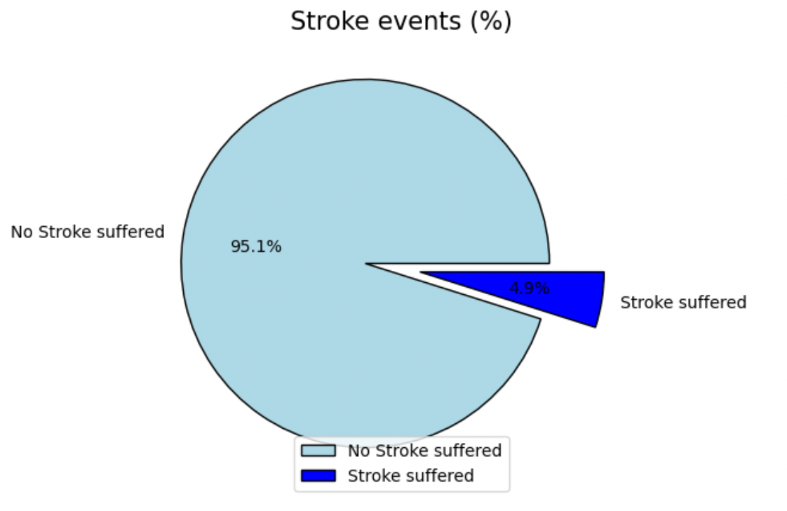
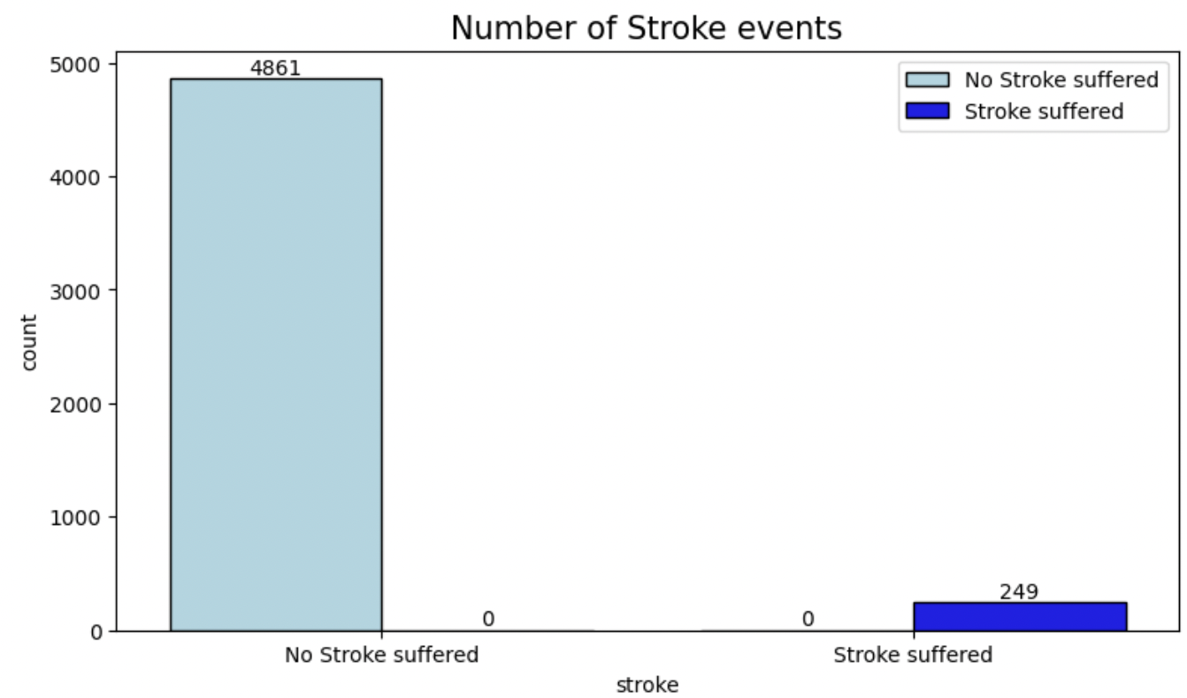
DATA EXPLORATION INSIGHTS
Plot for the target variable-

Slide 7


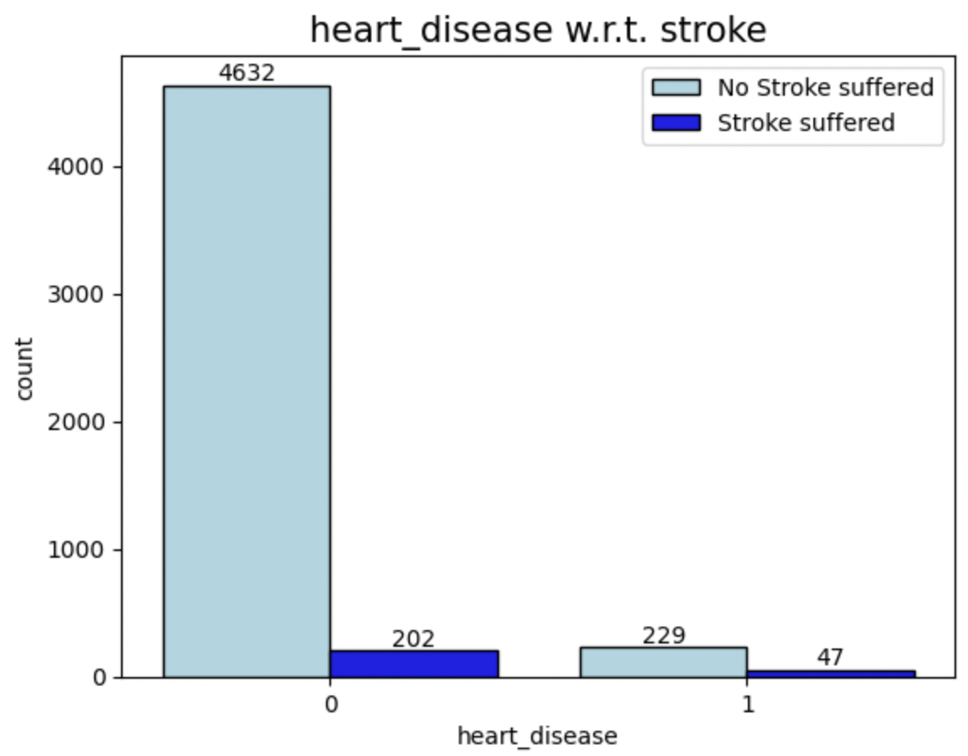
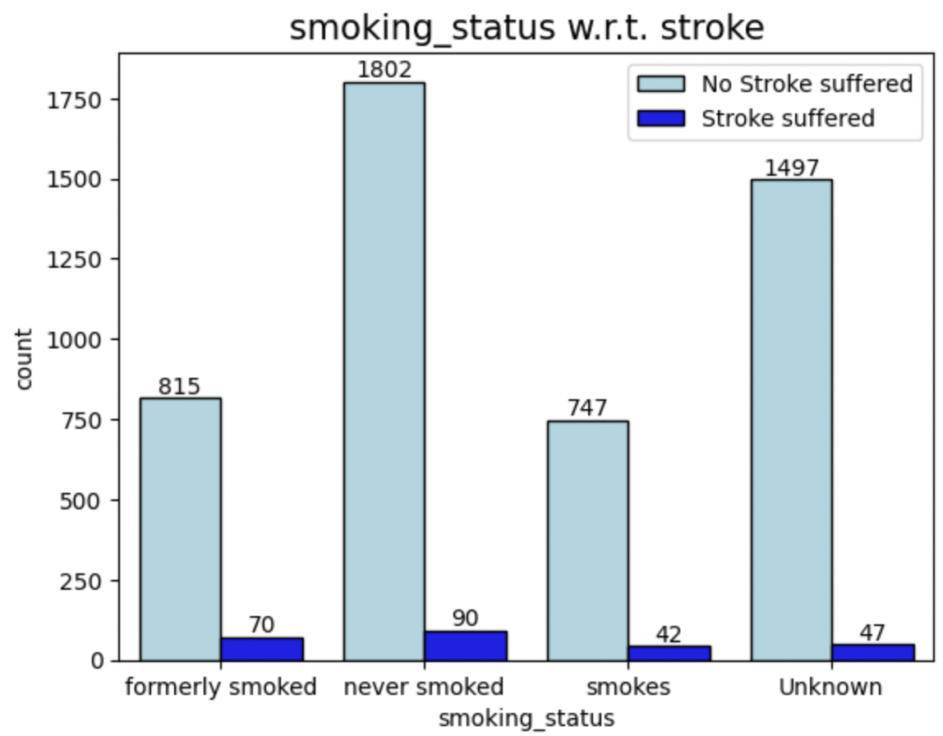
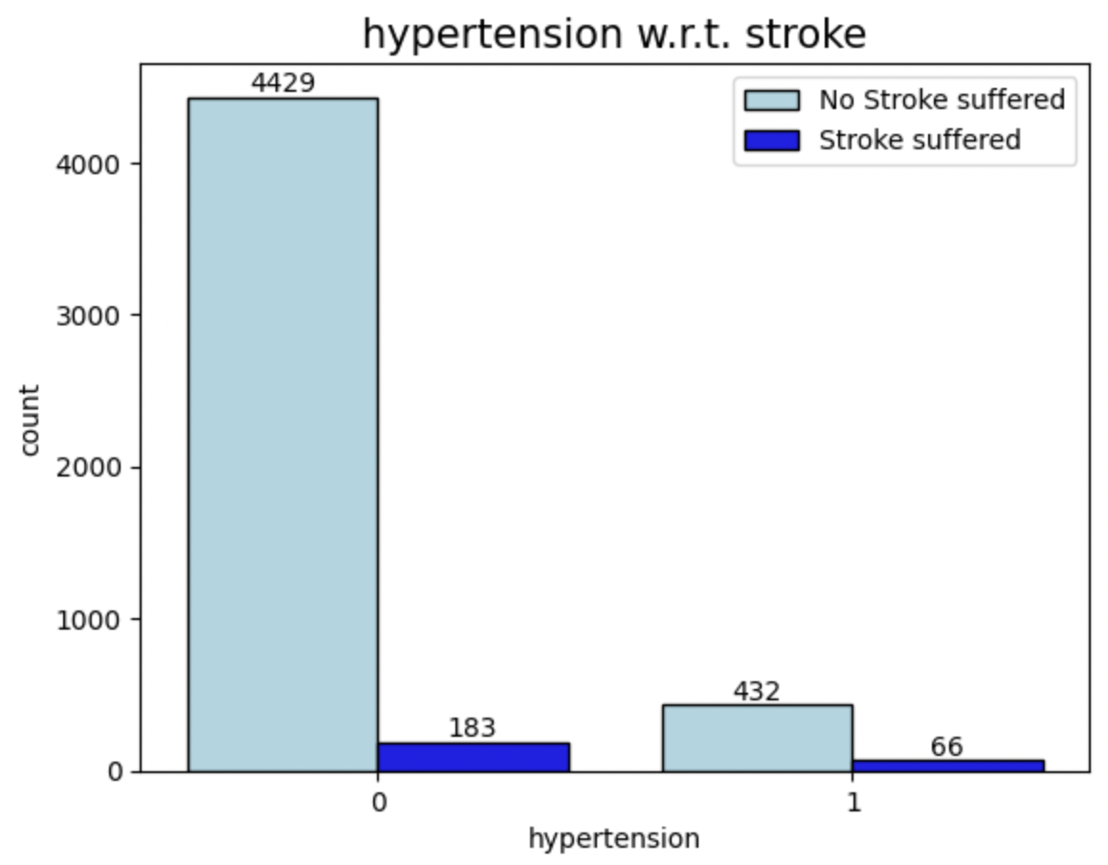
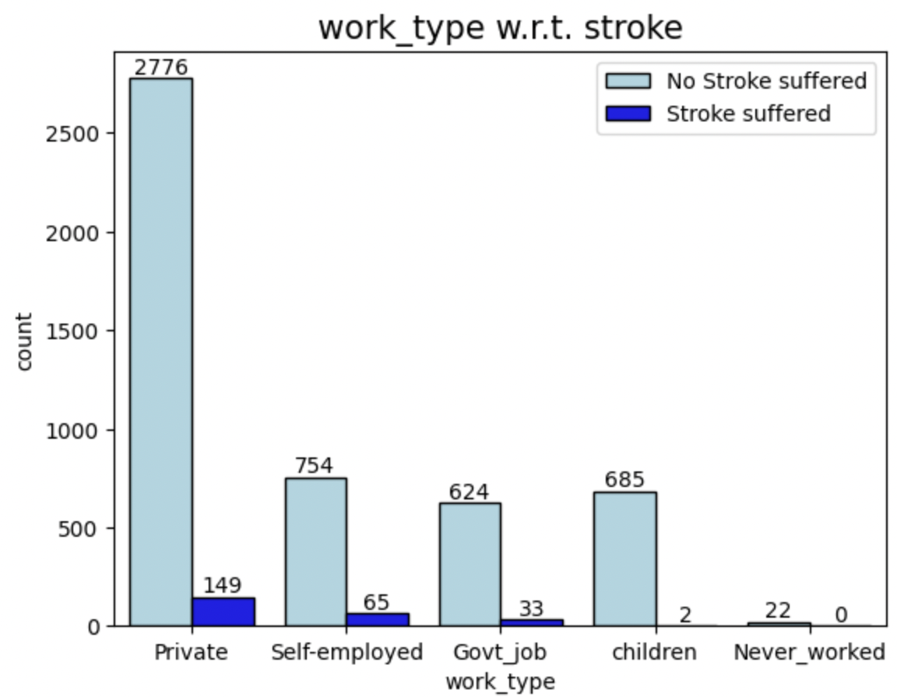
DATA EXPLORATION INSIGHTS
FEATURES WITH RESPECT TO EACH CLASS OF TARGET VARIABLE

Slide 8
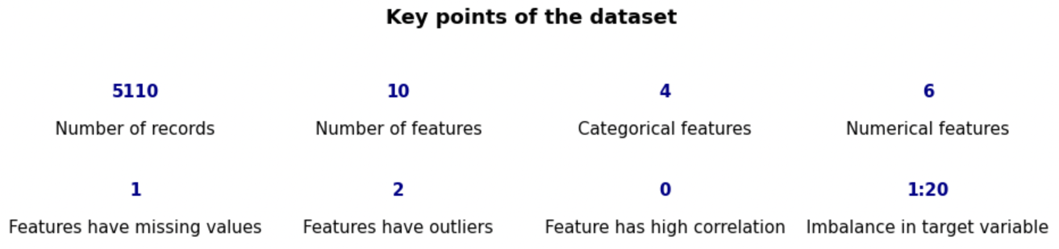
DATA EXPLORATION INSIGHTS

Slide 9
DATA PREPROCESSING
Data preprocessing is done to get the data ready for training the model. Following are the steps taken to do that-
Replace missing values
Deal with the outliers/extreme values
Perform label/one hot encoding
Split dataset into test and train
Perform class balancing operations - most crucial

Slide 10
MODEL TRAINING & HYPERPARAMETER TUNING
Three different algorithms are used RandomForest classifier, Logistic regression and SVM
The dataset for stroke detection is imbalanced, with an unequal distribution of classes within the dataset
The number of people not suffering the stroke is 4861 and the ones suffering a stroke are 249
To overcome this skewness, different resampling techniques are used in order to improve the accuracy and quantify the parameters
To understand which resampling technique is better, we have compared the ROC-AUC for them
ROC curve is to assess the overall diagnostic performance and AUC stands for area under the ROC curve
We have trained the RandomForest algorithm with two dataset, one with undersampling and other with synthetic minority oversampling technique (SMOTE)
Hyperparameter tuning is performed to optimize the model and get the best possible accuracy
To achieve this, Random search cross validation is used which works by splitting the dataset into random groups to find the best parameters to train the model

Slide 11
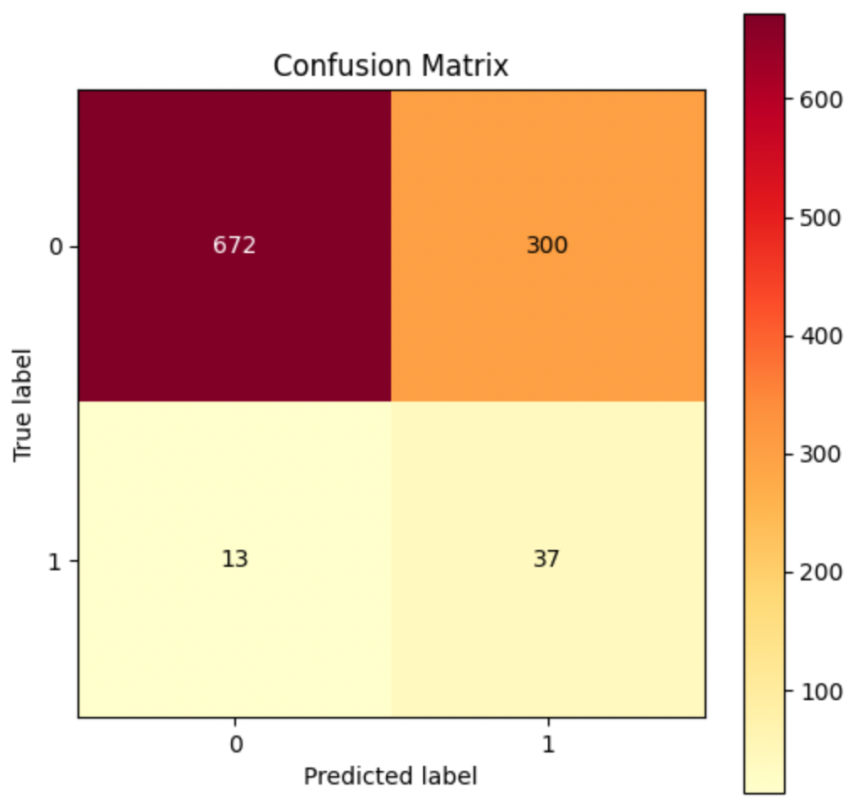
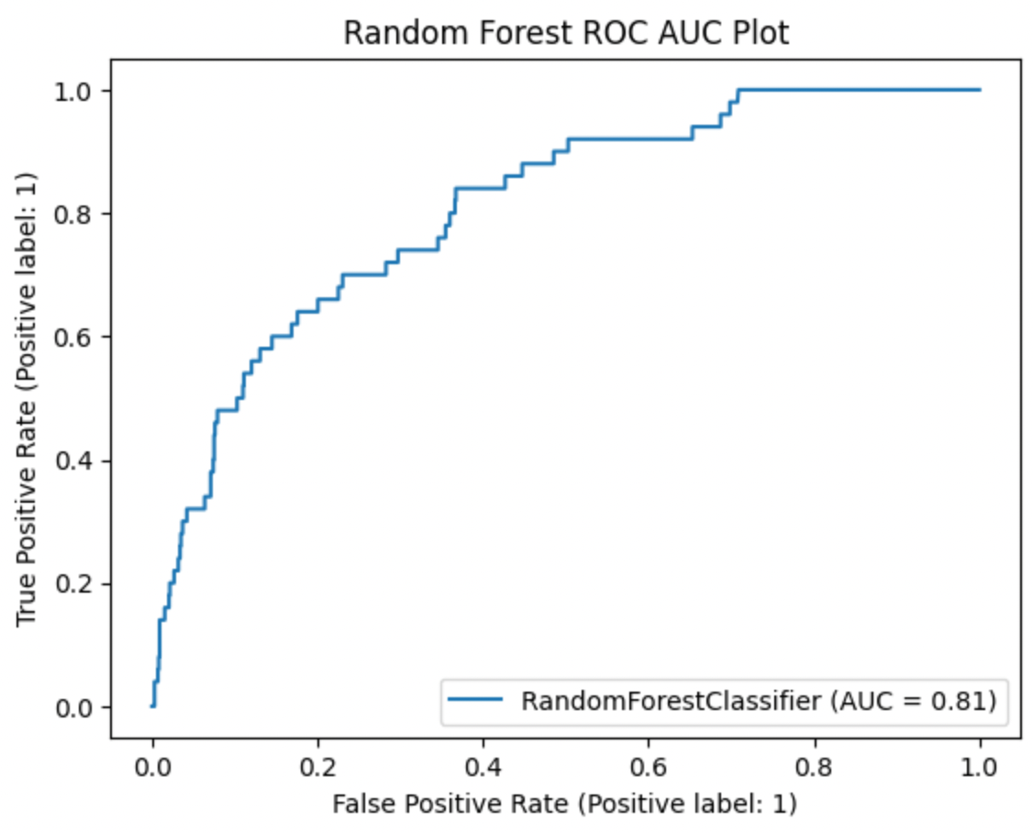
RANDOM FOREST CLASSIFIER
A random forest is a meta estimator that fits decision tree classifiers on subsets of the data
It can perform both the regression and classification tasks and handles large datasets efficiently
Random forest classifier is trained with two datasets with undersampling and oversampling
The ROC and AUC score of undersampling (0.8) is better than SMOTE oversampling (0.74)
In our next algorithms, we will be using undersampled dataset to train the model
The ROC AUC score for the random forest classifier is 0.8, the accuracy is 0.69 and recall is 0.66

Slide 12
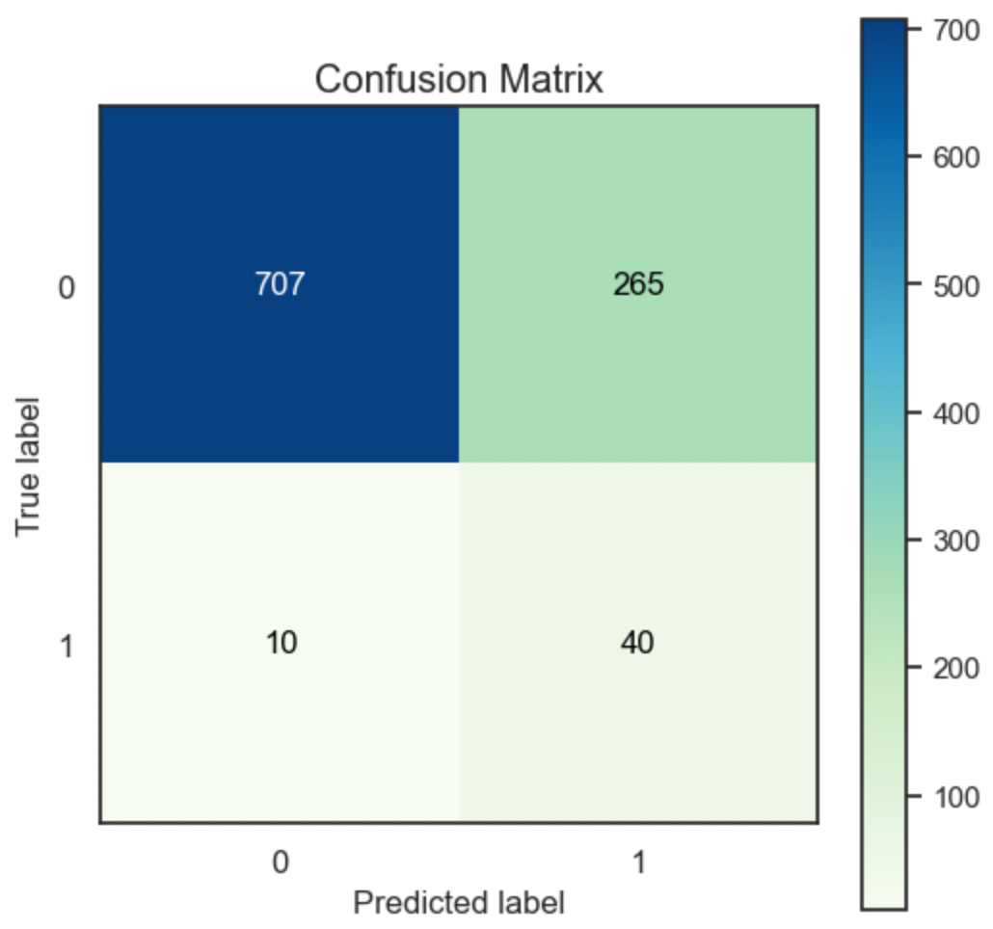
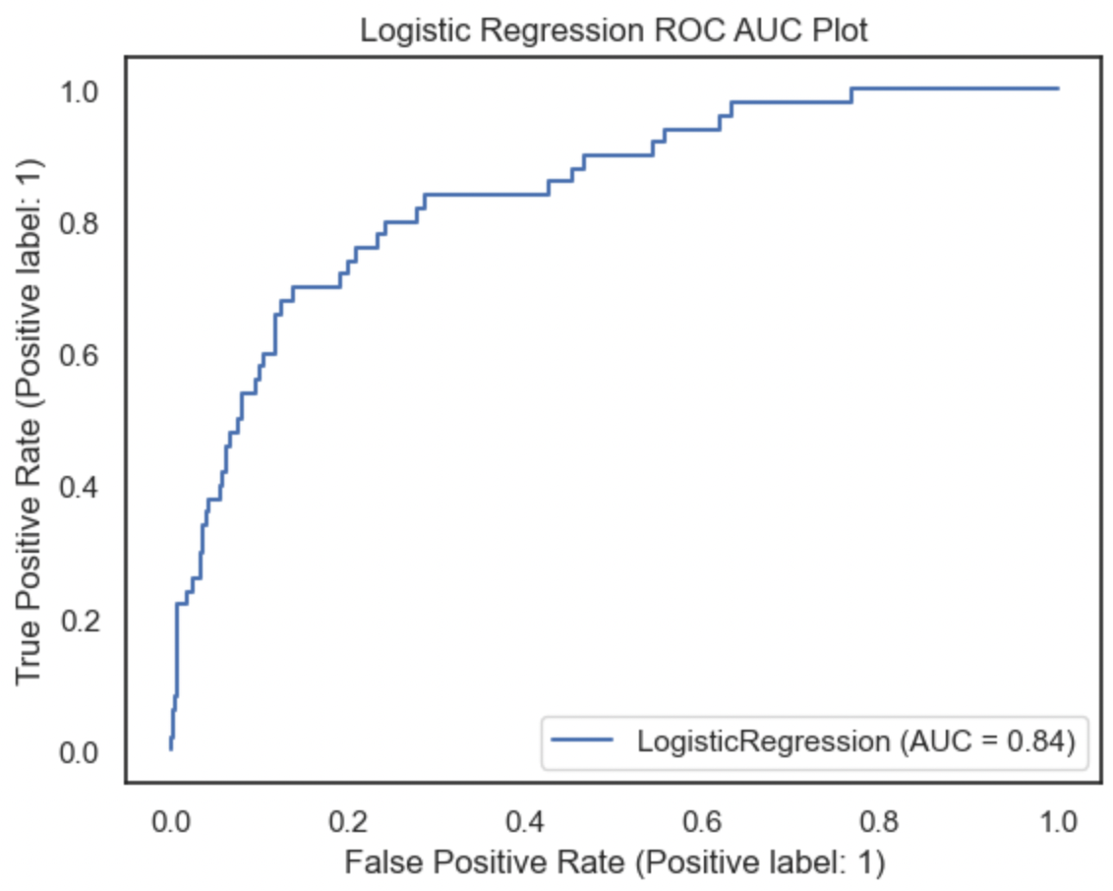
LOGISTIC REGRESSION
Logistic regression algorithm has ROC AUC score of 0.84, Accuracy of 0.73 and recall is 0.73

Slide 13

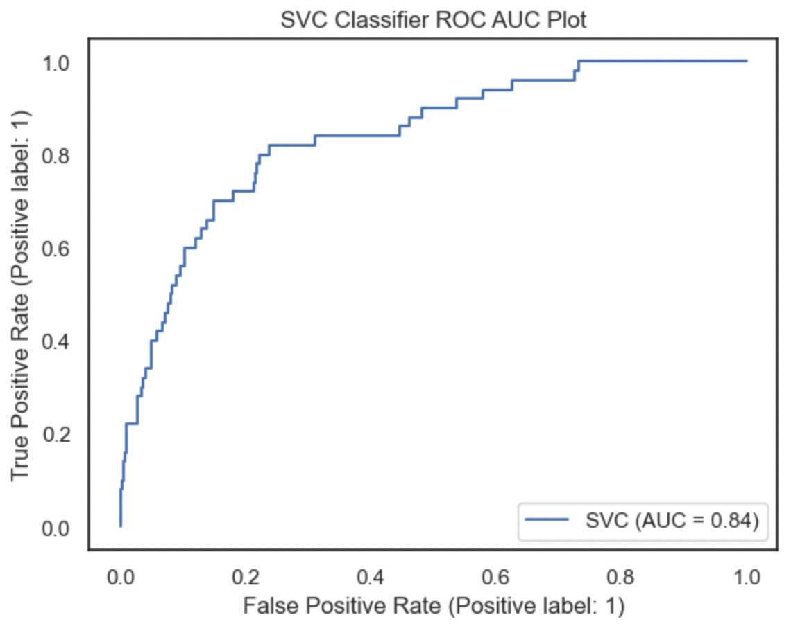
SVM
SVM algorithm has ROC AUC score of 0.83, Accuracy of 0.73 and recall of 0.71

Slide 14
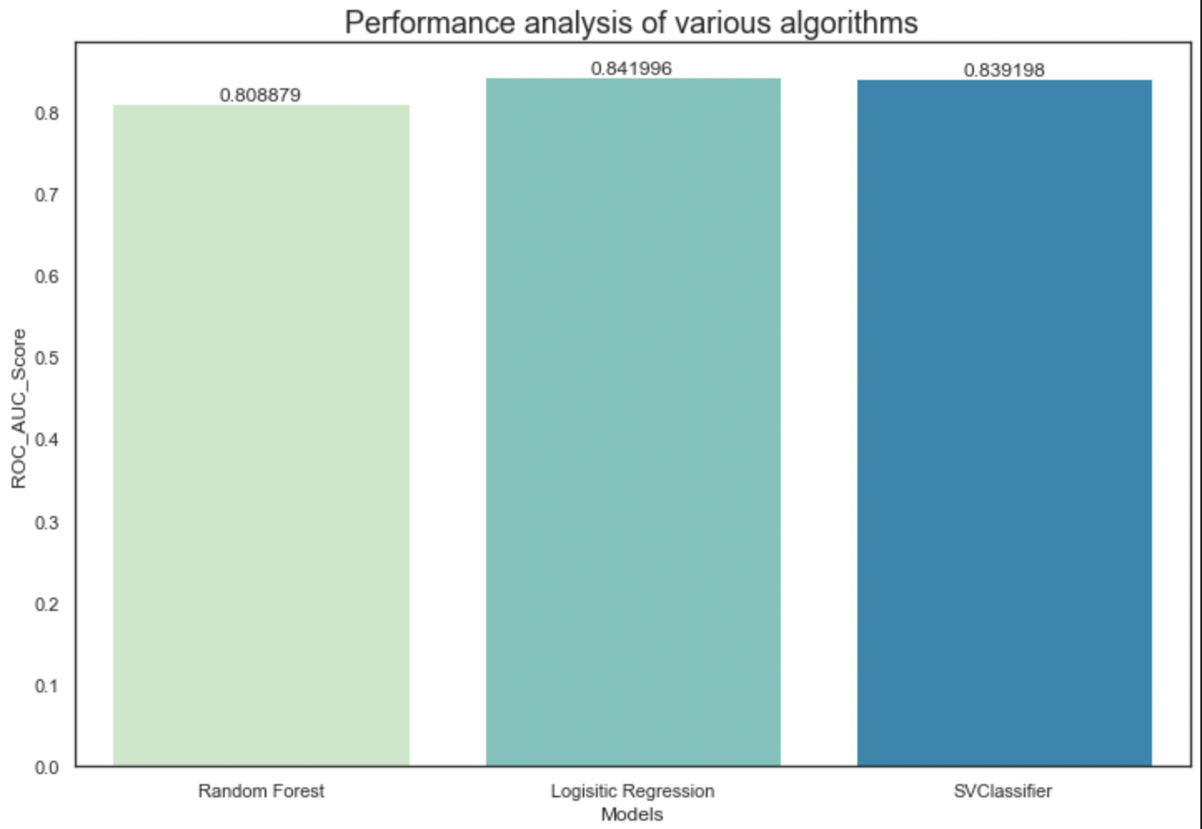
CLOSING REMARKS
Multiple models were trained using Random Forest Classification, Logistic Regression and SVM
Since this was an imbalanced dataset it doesn't make sense to consider accuracy as a performance metric as models that are only capable of making accurate predictions for the majority class will appear to be very effective
We will use ROC AUC score and Recall as our performance metric
From the comparison, we can see that logistic regression and SVM ROC AUC score is nearly similar, but logistic regression has higher recall. Higher recall means that model returns most of the relevant results. Hence, the tuned logistic regression model is the best model for our use case

Slide 15
THANK YOU!

